Slide 1

selenium sentinels team members
1. Monika GR
2. Aswini
3. Bhavana
4. Aishwarya Singh
5. Madhu Priya
6. Satya Manasvi
7. Govindu Shanmukha

Slide 2
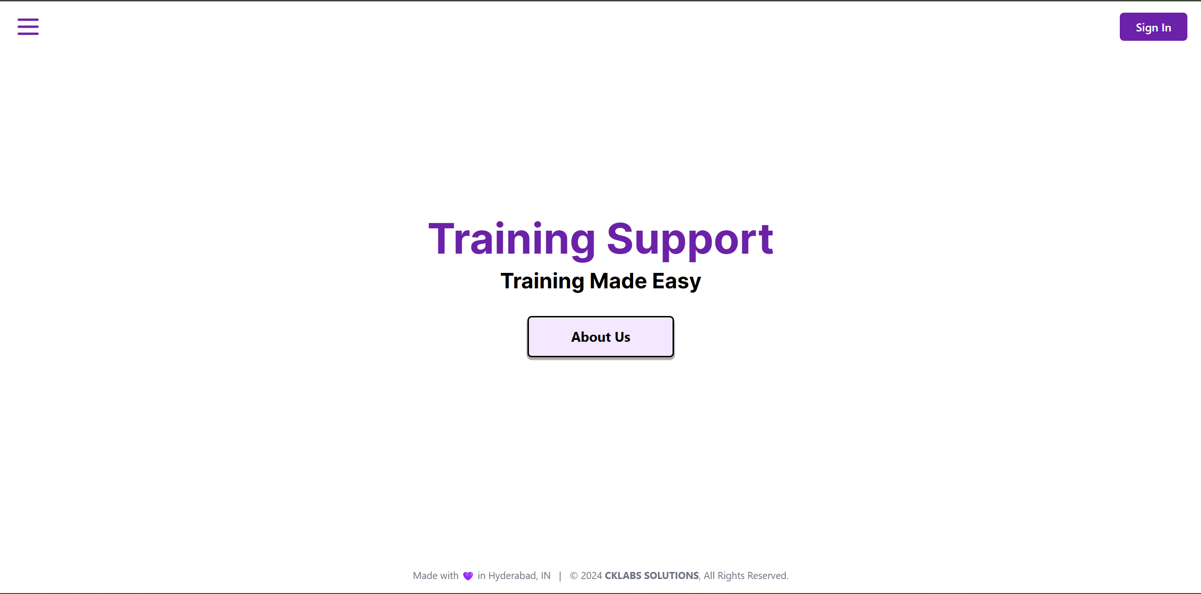

Slide 3
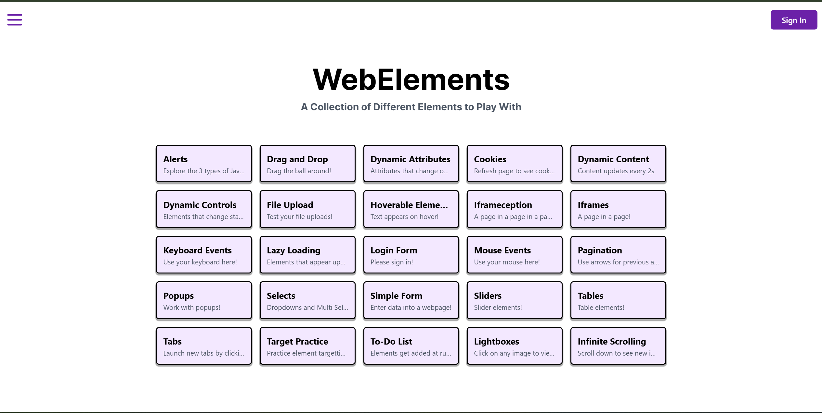

Slide 4
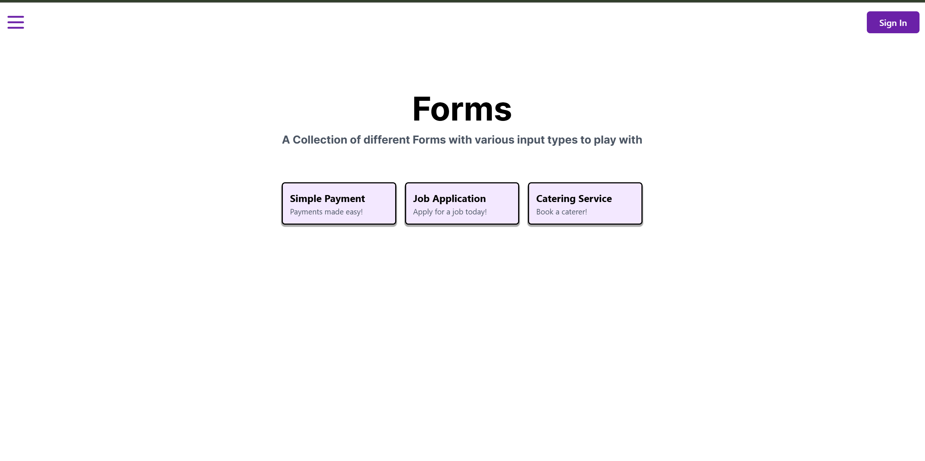

Slide 5
workflow
1
Project Selection – Training Support
2
Jira to plan tasks and WBS
3
Testcase Templates
4
5
Status update in jira
Testcases are written using POM

Slide 6
Testcase templates

Slide 7
Page Object model

Slide 8
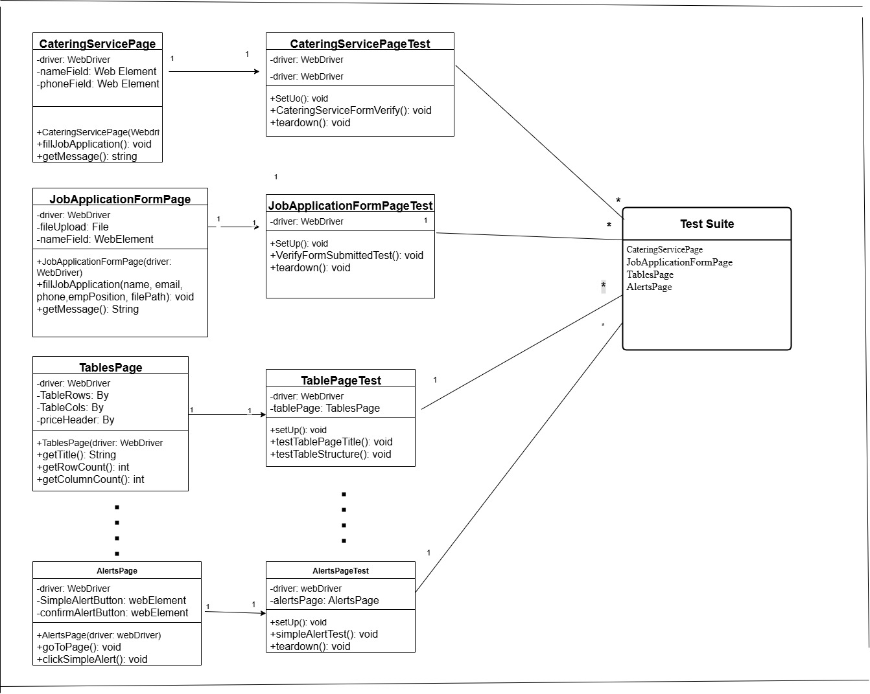
Class diagram

Slide 9
Project Execution

Slide 10


